Slide 1

Organizational Culture
Essentials of Organizational Behavior, 8/e
Stephen P. Robbins
Chapter 14
14-1

Slide 2
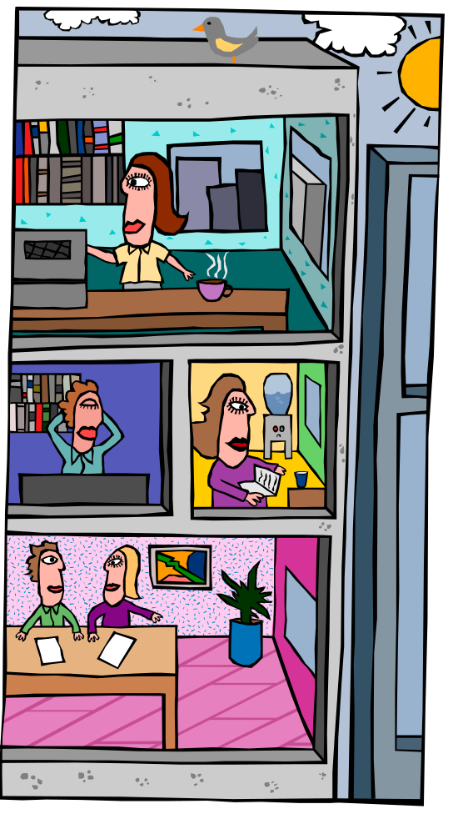
Organizational culture
Set of key characteristics that the organization
values that
distinguishes
the organization
from other
organizations
14-<number>

Slide 3
Stability
Innovation and
risk taking
Team
Orientation
Characteristics of Organizational Culture
Attention to
Detail
People
Orientation
Outcome
Orientation
14-<number>

Slide 4
Organizational culture is concerned with how employees perceive the seven characteristics, not whether they like them
14-<number>

Slide 5

Do Organizations Have Uniform Cultures?
A dominant culture expresses the core values that are shared by a majority of the organization’s members
14-<number>

Slide 6

Do Organizations Have Uniform Cultures?
Subcultures tend to develop in large organizations to reflect common problems, situations, or experiences that members face
14-<number>

Slide 7
A strong culture is characterized by the organization’s core values being both intensely held and widely shared
A weak culture is characterized by vagueness, ambiguity, and/or inconsistencies
14-<number>

Slide 8
Culture’s Functions
Boundary-defining role
Conveys a sense of identity
Facilitates the generation of commitment
Enhances social system stability
Sense-making and control mechanism
14-<number>

Slide 9
Culture as a Liability
Shared values do not agree with organization’s effectiveness
Environment is dynamic
Entrenched culture in rapid change
Hinders ability to respond to changes
14-<number>

Slide 10



How a Culture Begins
Ultimate source of an organization’s culture is its founders
14-<number>

Slide 11
Keeping a Culture Alive
Selection
Top Management
Socialization
14-<number>

Slide 12
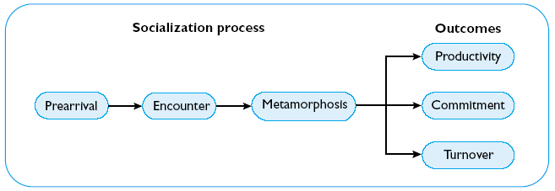
A Socialization Model
14-<number>

Slide 13
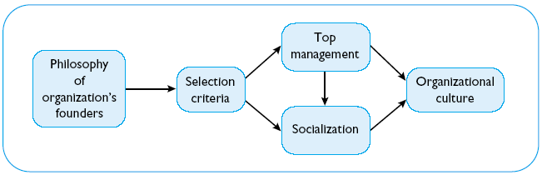
How Cultures Form
14-<number>

Slide 14
Stories
How
Employees
Learn Culture
Language
Rituals
Material
Symbols
14-<number>

Slide 15
Managing Cultural Change
Cultural change is most likely to take when the following conditions exist -
Dramatic crisis exists or is created
Turnover in leadership
Young and small organization
Weak culture
14-<number>

Slide 16

Creating an Ethical
Organizational Culture
Be a visible role model
Communicate ethical expectations
Provide ethical training
14-<number>

Slide 17
Creating an Ethical
Organizational Culture
Visibly reward ethical acts and punish unethical ones
Provide protective mechanisms
14-<number>

Slide 18
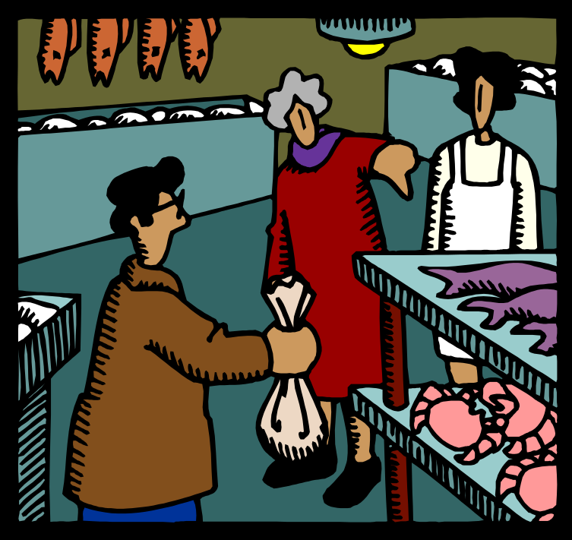
Creating a Customer Responsive Culture
Companies recognize this is the path to customer
loyalty and
long-term
profitability
14-<number>

Slide 19
Key Variables Shaping Customer-Responsive Cultures
Type of employees
Low formalization
Widespread use
of empowerment
14-<number>

Slide 20

Key Variables Shaping Customer-Responsive Cultures
Good listening skills
Role clarity
Employees who exhibit organizational citizenship
behavior
14-<number>

Slide 21
Managerial Action
Selection
Training and socialization
Structural design
Empowerment
Leadership
Performance evaluation
Reward systems
14-<number>

Slide 22
Workplace Spirituality
Recognizes that people have an inner life that nourishes and is nourished by meaningful work that takes place in the context of community
14-<number>

Slide 23

Characteristics of
Spiritual Organizations
Strong sense of purpose
Focus on individual development
14-<number>

Slide 24
Characteristics of
Spiritual Organizations
Trust and openness
Employee empowerment
Toleration of employee
expression
14-<number>

Slide 25
Paradox of Diversity
Two Conflicting Goals
  Employees accept the organization’s dominant values
  Encourage the acceptance of differences
14-<number>

